Slide 1
13 CHARACTERISTICS OF HIGH PROPENSITY DONORS

Slide 2
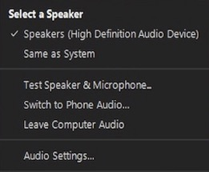
AUDIO
Check Audio Settings
Test Your Speakers
Switch to Phone
Notes:
[JEN]
First, we want to be sure you are not having any issues with the audio today. Hopefully you are able to hear me fine right now, but if you are having problems, you have a minute here to try to solve that. You should see an Audio Settings tab along your Zoom tools bar. Click that to open your options. You can test your speaker here, switch to making a phone call and you can check your settings. If you choose to call in, your phone number can be found in your confirmation and reminder emails.
If you continue to have difficulties, you can send me in a question in the Q&A and I will try my best to trouble shoot for you.
[CLICK]

Slide 3
QUESTIONS
Notes:
[JEN]
Next, we really want to encourage your participation in the webinar today by sending in questions. However, we ask that you do NOT use the “Chat” feature, and actually that should show as being disabled, but instead please use the Q&A tab. It is located in your Zoom tool bar probably very close to the chat tab… Type in your question, click anonymously if you don’t want us to know who you are… and click the Send button. Please feel free to send your questions in throughout the presentation, and the presenter will address them at the end.
[CLICK]

Slide 4
13 CHARACTERISTICS OF HIGH PROPENSITY DONORS

Slide 5
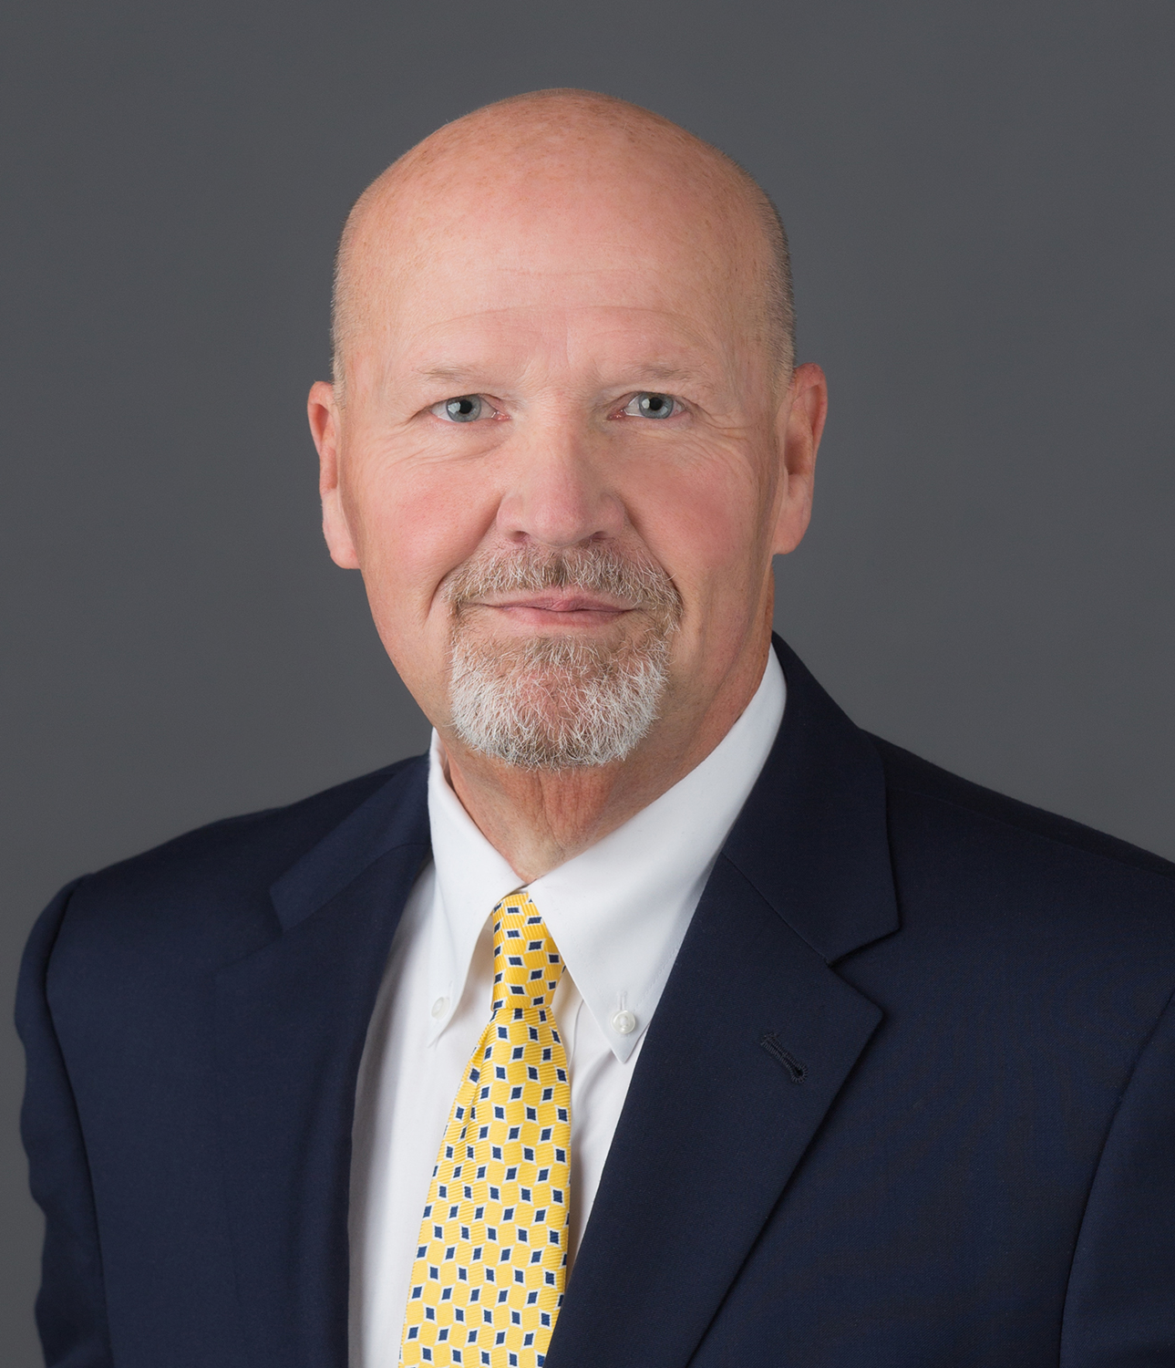
PRESENTER
Provides leadership and direction to over 35 seasoned charitable estate planners
Has planned thousands of estates, which has generated billions of dollars to charity during his thirty plus years working with nonprofits
Speaks to organizations from coast to coast on successful fundraising techniques, nonprofit management and charitable estate planning
Serves as the Chair of the Charitable Estate Planning Institute, a 501(c)(3) public charity offering top level education on charitable estate planning for development staff, gift planning officers and professional advisors
Obtained his Doctor of Education in Higher Education Administration from Vanderbilt University. His doctoral dissertation was on successful fundraising methods.
Eddie Thompson, Ed.D., FCEP
Founder and CEO
Thompson & Associates
Notes:
[NATHAN]
Eddie is the FOUNDER AND CEO of THOMPSON & ASSOCIATES, which provides leadership and direction to over 35 seasoned charitable estate planners with an inspiring sense of generosity, integrity and passion for helping others. By creating a unique values-based model at Thompson & Associates, Eddie and his team have established a way for people to dedicate the necessary time to consider important life decisions and to engage in thoughtful discussion that leads to optimal results for all.
Eddie has planned thousands of estates, which has generated billions of dollars to charity during his thirty plus years working with nonprofits. He speaks to organizations from coast to coast on successful fundraising techniques, nonprofit management and charitable estate planning and has garnered many honors during his distinguished career.
Eddie serves as the Chair of the Charitable Estate Planning Institute, a 501(c)(3) public charity offering top level education on charitable estate planning for development staff, gift planning officers and professional advisors. Eddie and a group of Thompson & Associates colleagues formed the Institute in 2012. He is also a Fellow in Charitable Estate Planning (FCEP) awarded by the Institute.
Eddie obtained his Doctor of Education in Higher Education Administration from Vanderbilt University. His doctoral dissertation was on successful fund raising methods.
A native of Florida, Eddie and his wife, Sheryl, have been married over more than 40 years and have made Nashville their home. They have two sons and four dogs. Thanks for being with us today Eddie… ad lib….

Slide 6
13 CHARACTERISTICS OF HIGH PROPENSITY DONORS

Slide 7
WHERE ARE NONPROFITS LOOKING FOR GIFTS?

Slide 8
WHERE ARE NONPROFITS LOOKING FOR GIFTS?

Slide 9
THREE TYPES OF DONORS

Slide 10
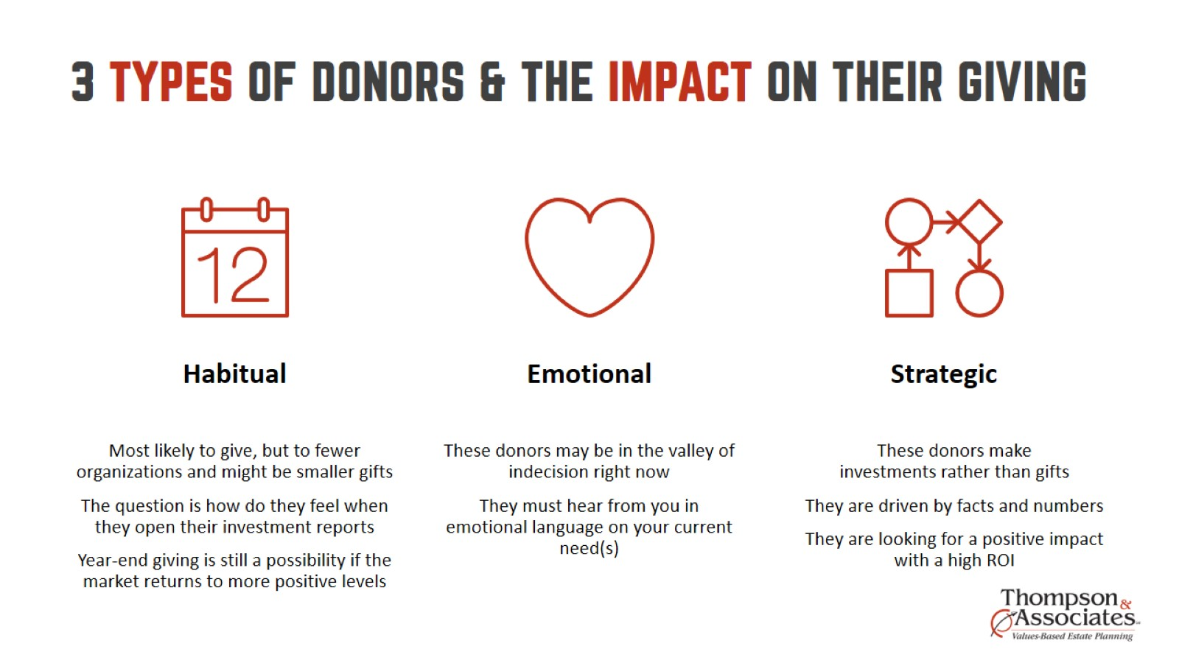
3 TYPES OF DONORS & THE IMPACT ON THEIR GIVING

Slide 11
Two Types of Wealth Accumulators

Slide 13
CONSISTENCY IN DONATING AT A HIGH LEVEL

Slide 14
NO CHILDREN

Slide 15
WITH CHILDREN

Slide 16
HIGHEST AMOUNT EVER DONATED In any one year during life

Slide 17
HAVING FUNDED A TRUST

Slide 18
FEMALE

Slide 19
WEALTHY

Slide 20
NOT MARRIED

Slide 21
GROWING TRAJECTORY OF WEALTH Leading up to death

Slide 22
CONSISTENCY IN VOLUNTEERING

Slide 23
religious

Slide 24
HEALTH-RELATED

Slide 25
AGE

Slide 26
Is this the golden age of planned giving?

Slide 27
A SIMPLE TOOL To help donors decide how much & when to give to heirs

Slide 29
Q&A
Eddie Thompson, Ed.D., FCEP
Founder and CEO
Thompson & Associates
www.ceplan.com
Notes:
Answer questions.
With about 1:00 left, Jen will go to next slide…

Slide 30
Additional questions
eddie@ceplan.com
nathan@stelter.com
jen.lennon@stelter.com
www.stelter.com
Notes:
[JEN]
That’s all the time we have for today… If we didn’t get to your question, or if you have further questions on what was presented today, please feel free to reach out to Eddie, Nathan or myself. And if you have questions on Stelter’s products or services, please visit us at stelter.com and you can email us at stella@stelter.com for more information….
CLICK

Slide 31
Webinar resources
Recording
Presentation handouts
www.stelter.com/webinars
Notes:
[JEN]
And finally, As an industry leader in planned giving marketing, Stelter is committed to providing innovative solutions and education for your marketing needs. We are happy to provide you with this complimentary webinar today, and will also be making the recording and slides available for you to access.
So, in a few days you will receive an email instructing you when the materials are available on our website. There you will be able to access the recording of the presentation as well as the handout slides.

Slide 32
13 CHARACTERISTICS OF HIGH PROPENSITY DONORS

